Slide 1
Volume of a Rectangular P rism

Slide 2
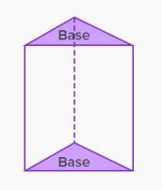
What do we know about prisms?
• A prism is a solid object that has parallel and congruent bases that are both polygons.
• Prisms are named for the shape of the base.
- Rectangular prism (has rectangular bases)
- Triangular Prism (has triangular bases)

Slide 3
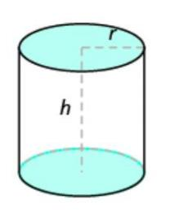
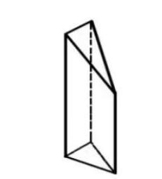
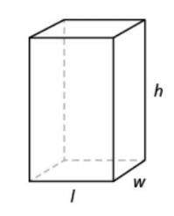
Are they prisms or not? Why?
A cylinder is not a prism
because it has curved
sides. A prism is a
polyhedron, which means
Not a prism
Ends are not
parallel
all faces are flat.
A rectangular prism is a solid three- dimensional object that has 6 faces that are rectangles.
A rectangular prism

Slide 4
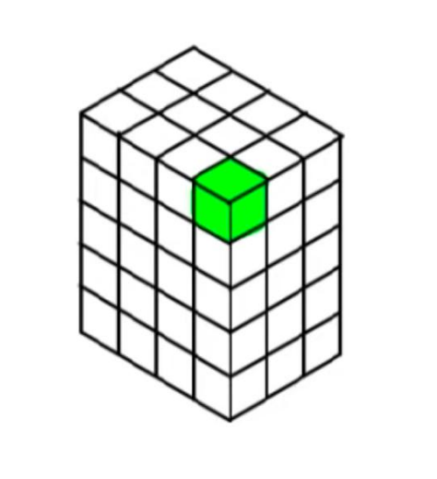
Volume
Volume is measured by how many cubic units it would take to fill a given space.
The cube shaded green is a cubic unit. The amount of cubic units it take to fill a defined space is what we call volume.
Volume is the amount of 3- dimensional space something takes up.

Slide 5
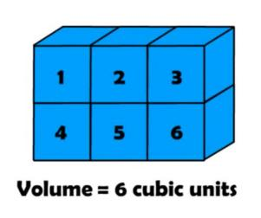
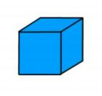
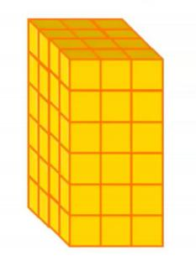
A unit cube
Measuring Volume by Counting Unit Cubes

Slide 6
Activity
• go to this website ( https://www.nctm.org/Classroom- Resources/Illuminations/Interactives/Cubes/ ) and explore methods of finding the volume of rectangular prisms. You can use the “Customize” wheel to change the width, depth, and height to see boxes of various sizes and fill the box with cubes, rows of cubes, or layers of cubes. You can also randomize the dimensions by clicking on the “Next” arrow.
• If a rectangular prism has a volume of 24 cubic units, what could its dimensions be? Does it matter which dimensions you call length, width or height?

Slide 7
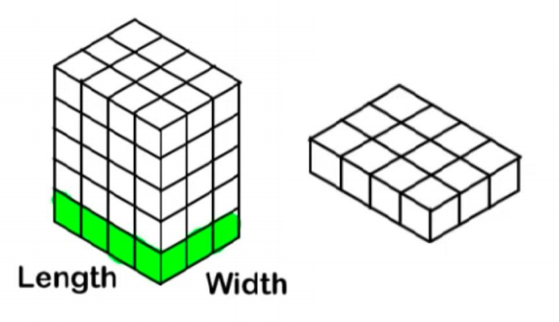
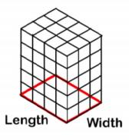
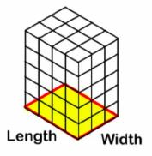
Formula
For rectangular prisms:
Volume = area of the base × height
Volume = (length × width) × height

Slide 8
When specific unit measurements are provided, the volume is labeled accordingly.
Unit of Measurement | Unit of Volume
inches | cubic inches or in³
feet | cubic feet or ft³
centimeters | cubic centimeters or cm³

