Slide 1
Volume of a Rectangular Prism

Slide 2
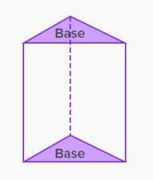
What do we know about prisms?
• A prism is a solid object that has parallel and congruent bases that are both polygons.
• Prisms are named for the shape of the base.
- Rectangular prism (has rectangular bases)
- Triangular Prism (has triangular bases)

Slide 3
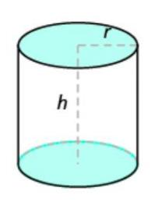
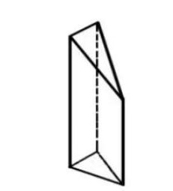
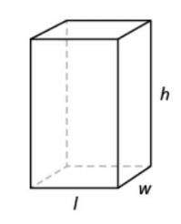
Are they prisms or not? Why?
Not a prism
Not a prism
A rectangular prism

Slide 4
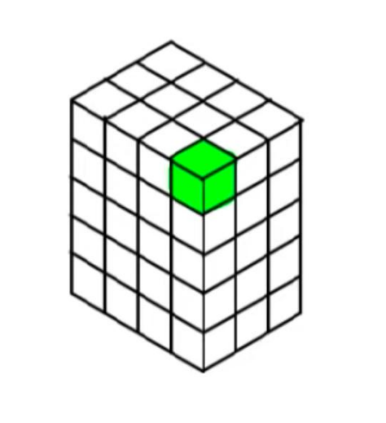
Volume
Volume is measured by how many cubic units it would take to fill a given space.

Slide 5
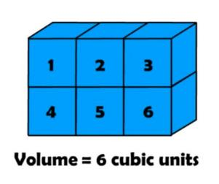
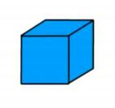
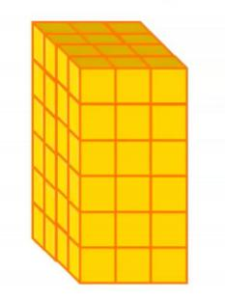
A unit cube
Measuring Volume by Counting Unit Cubes

Slide 6
Activity
https://www.nctm.org/Classroom-Resources/Illuminations/Interactives/Cubes/
• Explore methods of finding the volume of rectangular prisms. You can use the “Customize” wheel to change the width, depth, and height to see boxes of various sizes and fill the box with cubes,rows of cubes, or layers of cubes. You can also randomize the dimensions by clicking on the “Next” arrow.
• If a rectangular prism has a volume of 24 cubic units, what could its dimensions be?Does it matter which dimensions you call length,width or height?

Slide 7
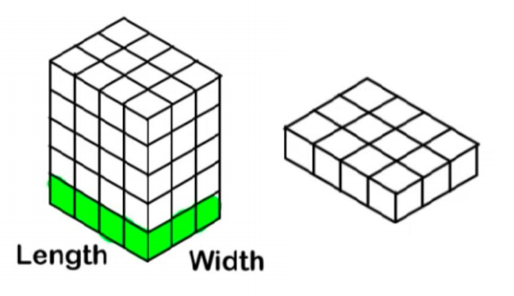
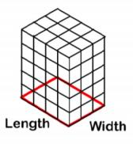
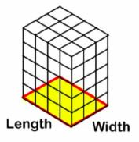
Formula
For rectangular prisms:
Volume = area of the base × height
Volume = (length × width) × height

